Slide 1


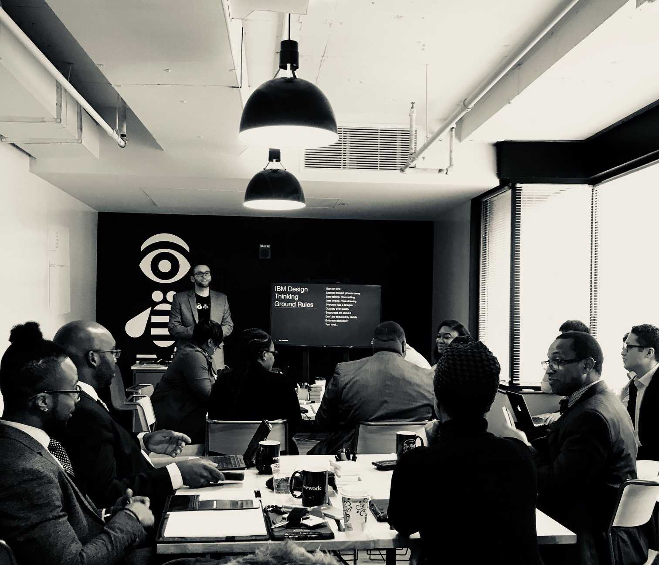
City of Seat Pleasant | IBM Design Thinking Workshop
January 23, 2018 IBM Studios, Washington, DC WeWork White House

Slide 2
Agenda
DAY ONE
Introductions
Problem Statement Definition
Personas + Empathy Mapping
As-is Scenarios
Lunch
Pain Points & Opportunities
Big Ideas
Prioritization
Road Mapping
9:00–9:30 AM
9:30–10:30 AM
10:30–11:30 AM
11:30 AM–12:30 PM
12:40–1:40 PM
1:45–2:30 PM
2:30–3:00 PM
3:00–3:30 PM
3:30 –4:30 PM
2

Slide 3
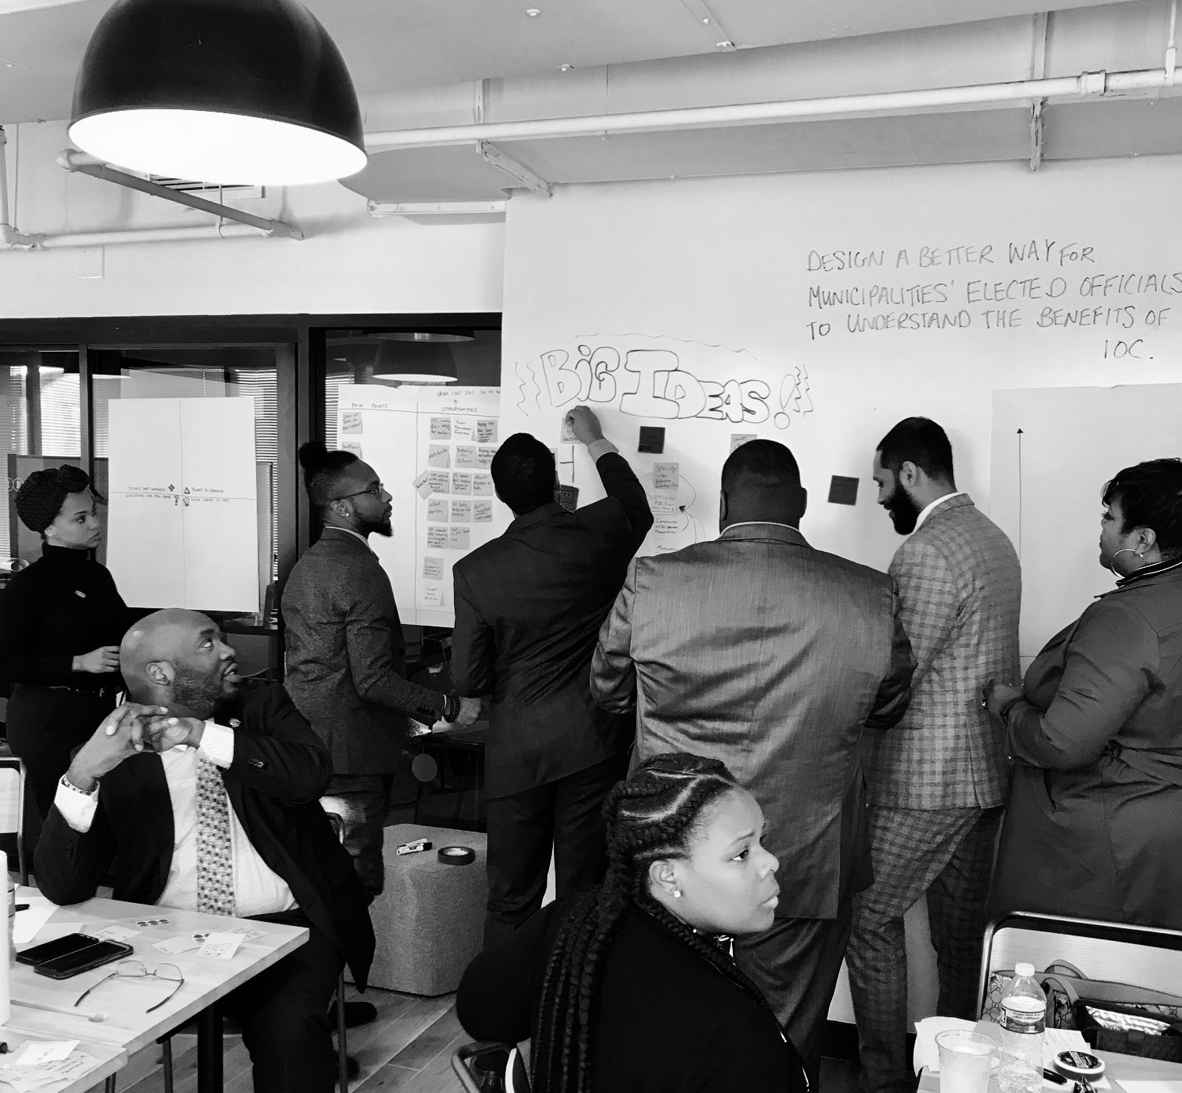
City of Seat Pleasant
Attendees
IBM
Eugene W. Grant Mohamed Abdelhameid Desiray Bowie Sharron Lipford Tanika Shields Sean Wilson Weyimi Ayu J.C. Riley Monica Biscoe Chris Valentine
Alex Brown Lauren Doyle Ron Kim Keith Van Leeuwen Thomas Coleman Michael Chiang
3

Slide 4
Problem Statements
1
Problem statements provide a focus on the specific needs that you have uncovered. A good problem statement should be human centered, broad enough for creative freedom, and narrow enough to manage.

Slide 5
Problem Statement
Problem Statement(s)
Design a better way for municipalities’ elected officials to understand the benefits of IOC.
Design a better way for citizens to learn how to use the IOC Connected App to solve their problem(s).
Problem Statement Discussion
Ultimately, the goal of this session is to identify the best means through which the City of Seat Pleasant can increase the number of municipalities subscribed to IOC. IOC is a shared service platform used to connect various IoT tools throughout a city into a single analytics touch point. For this session, we examined how both citizens and city officials would each benefit from a city leveraging IOC.
While city administrators, mayors and city council members all play a key role in the decision making, this session focused on the most influential elected official in a municipality. This person may in fact be the mayor, but could also be a council president or long-standing, well-respected member of the council. The key here is that this individual has the power to make or break an effort, therefore their understanding of the benefits of IOC is critical.
Decision makers who engage and collaborate with empowered citizens can gain valuable insights and drive beneficial outcomes for everyone. Citizens who lack an understanding of the benefits of an IOC are not engaged. When considering which citizens to evaluate for the session, the group found influencers to be most critical because of their exponential impact on other less connected citizens.
5

Slide 6
Personas
2
This activity helps identify project stakeholders. Once key stakeholders are identified, empathy maps are used to shed light on stakeholder expectations, relationships, what currently challenges them, what they need from you, and what you need from them. Empathy maps will be covered in the next section.

Slide 7
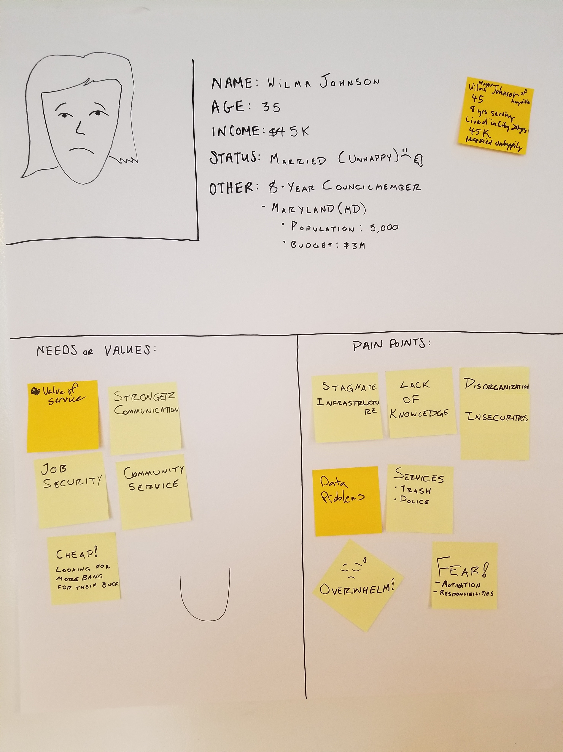
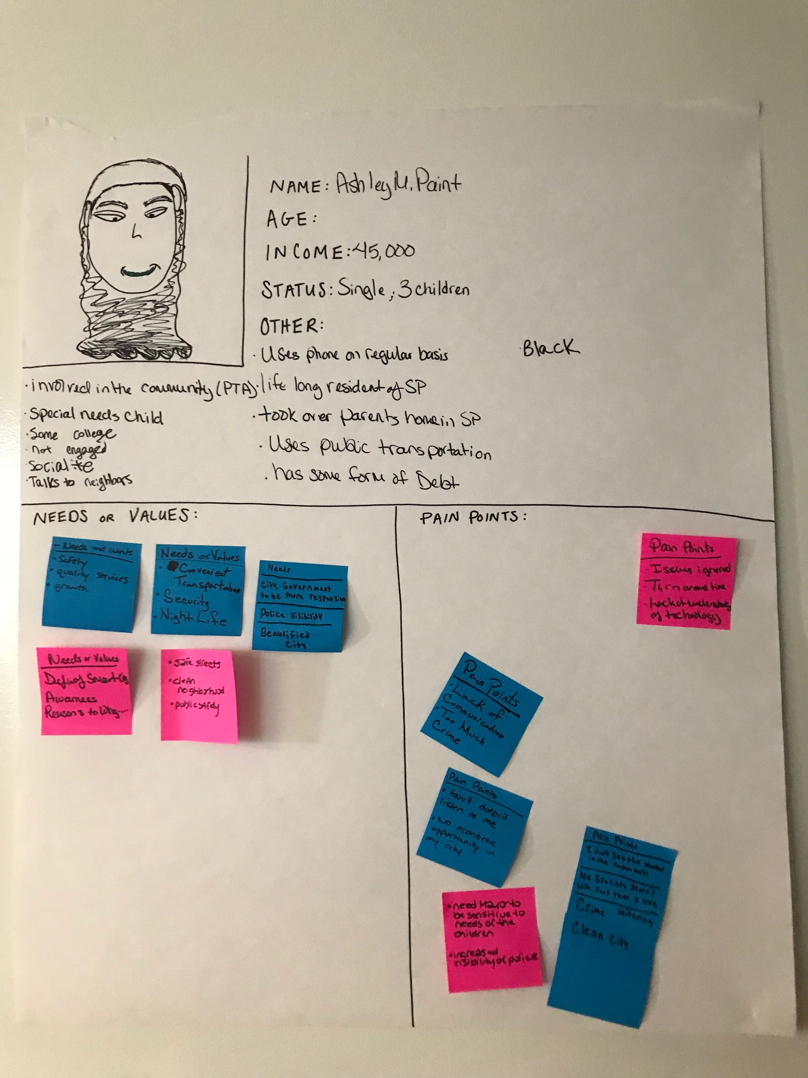
Personas: Wilma Johnson, Councilmember
Ashley M. Paint, Resident
Transcribed on the next page
9

Slide 8
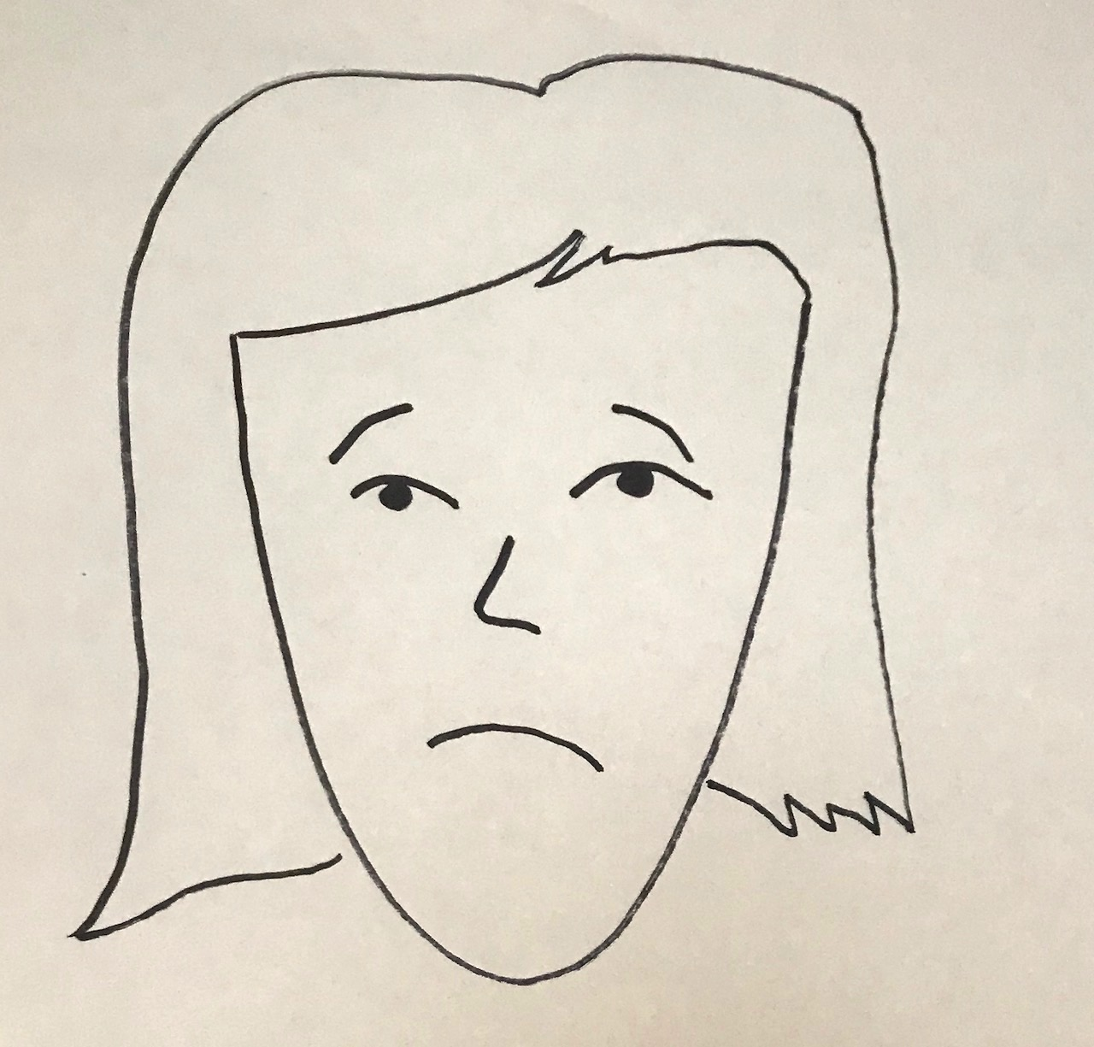
Persona: Wilma Johnson
Bio
35 years old
Status: Longtime resident of her city (20 yrs)
Income: 45,000
Married (Unhappily); No kids
8-year Maryland councilmember; Concerned with re-election
City Population: 5,000
City Budget: $3M
Needs or Values
Value of service
Stronger Communication
Job Security
Cost (More bang for their buck!)
Community Service
Pain Points
Stagnant infrastructure
Data problems
Overwhelmed by responsibilities
Motivated by fear
Disorganized
Insecure
Lack of knowledge
Services (i.e. Trash, Police)
7

Slide 9
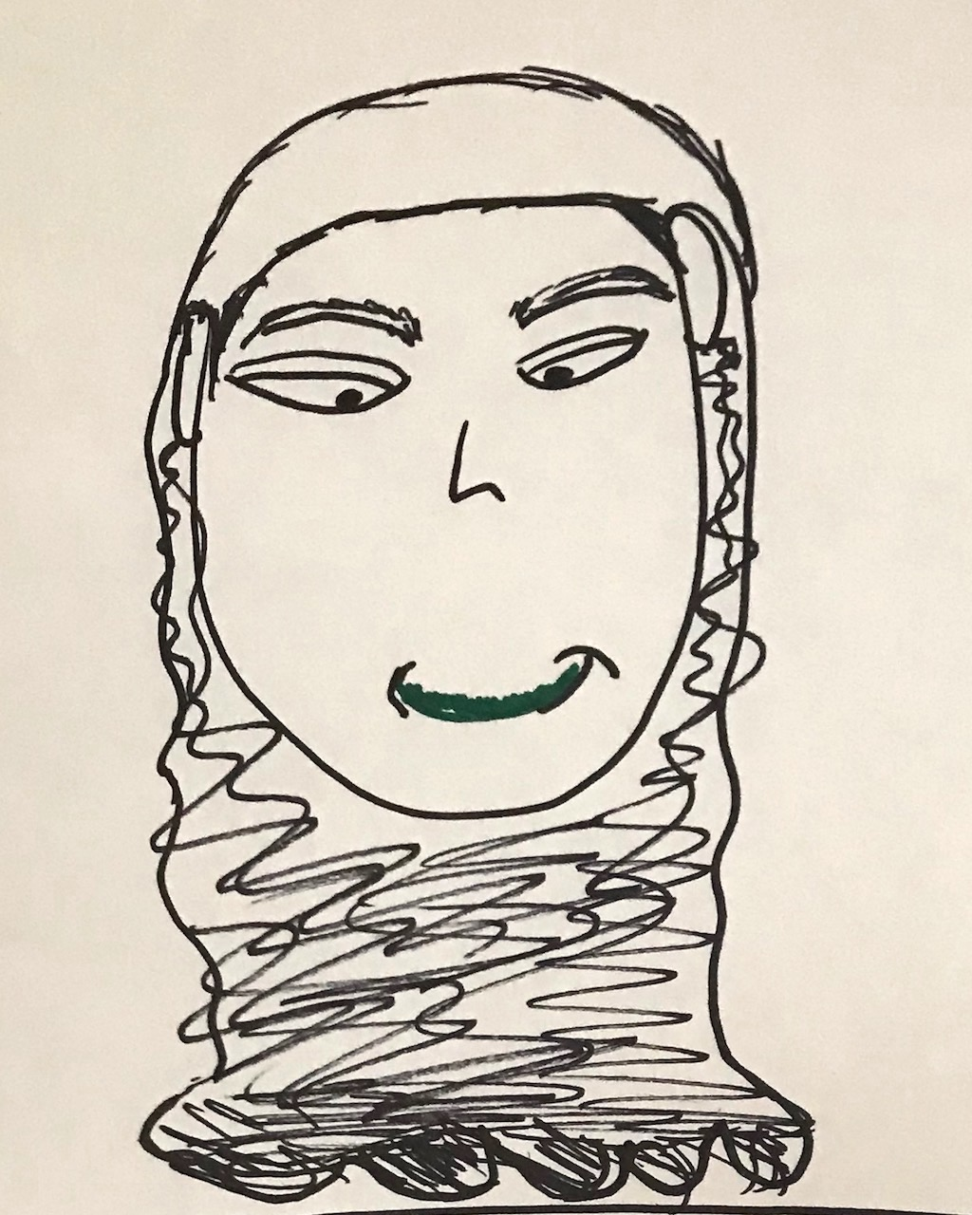
Persona: Ashley M. Paint
Bio
Lifelong resident of Seat Pleasant ; Took over her parents’ home
Income: 45,000 (carries debt)
Race: Black
Status: Single; 3 Children (one with special needs)
Does not have a 4-year college degree
Uses her phone on a regular basis; Talks to neighbors often; Not formally engaged in the community
Uses public transportation
Needs or Values
Safety and security
Quality services
Growth
Reasons to why…
Awareness
Clean Neighborhood
Night Life
Convenient transportation
Responsible city government
Visible public safety (i.e. Police)
City beautification projects
Sensitivity to her children
Pain Points
Lack of awareness
Government doesn’t listen
Too much Crime/ Loitering
No grocery store
Low government visibility
Clean city
Issues are ignored
Turn around time for problems is too long
Lack of understanding technology
7

Slide 10
Empathy Mapping
3
Empathy maps help to rapidly put your team in the user’s shoes and align on pain points and gains–whether at the beginning of the project or mid-stream when you need to re-focus on your user.

Slide 11
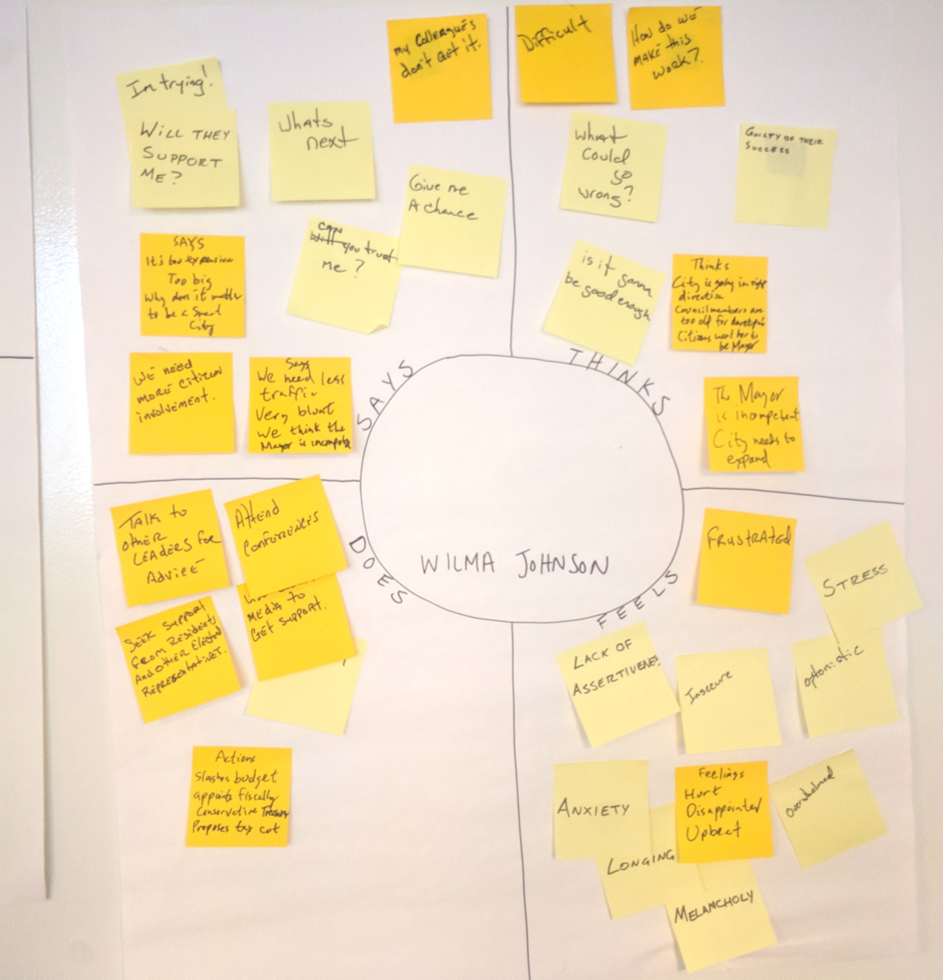
Empathy Map: Wilma Johnson, Councilmember
Transcribed on the next page
9

Slide 12
Empathy Map: Wilma Johnson
Says “I’m trying!” “Will they support me?” “What’s next?” “Give me a chance!” “Can you trust me?” “Why does it matter to be a smart city?” “We need more citizen involvement.” “We need less traffic.” “We think our mayor is incompetent.” “My colleagues don’t get it!” | Thinks This is difficult How can we make this work? What could go wrong? Is it going to be good enough? The city is going in the right direction Councilmembers are too old Citizens want her to be mayor The current mayor is incompetent This city needs to expand
Does Talk to other leaders for advice Seek support from residents and other elected representatives Attend conferences Seek media support Slash budget Appoint fiscally conservative treasurery Propose tax cut | Feels Guilty Frustrated Timid Anxious Longing Hurt Stressed Disappointed Insecure Overwhelmed Melancholy Optimistic Upbeat
11

Slide 13
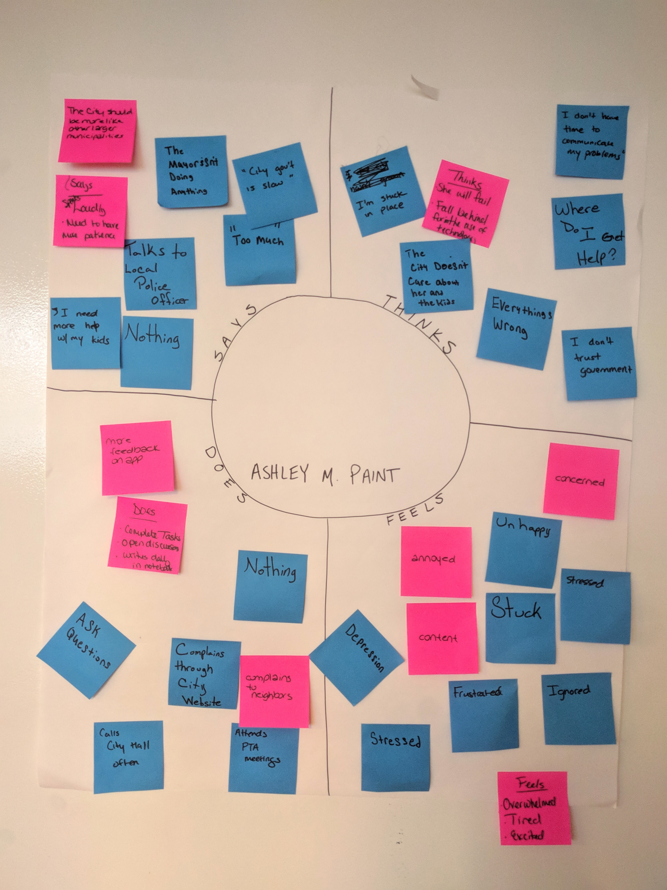
Empathy Map: Ashley M. Paint, Resident Transcribed on the next page
9

Slide 14
Empathy Map: Ashley M. Paint
Says “Our city should be more like other, larger municipalities!” ”I don’t have the patience for this!” ”I need more help with my kids.” ”Our Mayor isn’t doing anything.” “City government is slow” “This is too much for me to handle.” | Thinks I am stuck here. I will fail I’m falling behind on technology The city doesn’t care about me or my kids Everything is wrong Where do I get help? I don’t trust the government I don’t have time I don’t know how to communicate my problems
Does Talks to local police officer Provides feedback on app Asks questions Complains through city website Complains to neighbors Attends PTA meetings Calls City Hall often Does not take real action Does not communicate | Feels Depressed Annoyed Stressed Frustrated Stuck Ignored Unhappy Overwhelmed Tired Concerned Excited Content
11

Slide 15
As-Is Scenarios
4
As-is Scenario Maps help to document collective understanding of user workflows and are best used as precursors to exploring new ideas.

Slide 16
As-Is Scenario: Wilma Johnson
As-Is
Stages | Problem Statement | Execution | Outcome
Doing | Charter mandate Ask neighboring municipalities Collect data Make hypothesis about the best choice | Bid solicitation Choose Collector Handle special cases | Cleaner city
Thinking | How can I be more efficient Why does this cost so much money Why don’t I have any data to make this decision | I need to find a better way How do I find who dumped these tires | Is this as efficient as we could be
Feeling | Frustrated | Optimistic Frustrated (A bit later) | Some relief
17

Slide 17
As-Is Scenario: Ashley M. Paint
As-Is
Stages | Identifies a Problem | Voices Concern | Notifies City | City Addresses the Problem | Ashley Provides Feedback
Doing | Brainstorming Takes note of problem | Talks/ Gossips with neighbors Vents on her Facebook page | Calls City Hall/ Police Has to call multiple times Gets put on hold | Nothing Waits for the problem to be fixed | Giving praise and giving shade Tag city in Facebook post Write on city’s Facebook page
Thinking | This is crazy! “My kids!” | Ain’t nobody got time for all this! “What are they actually doing?” They don’t help poor people | My problem will not be addressed Governmentwon’t listen Where are my tax dollars going? | Is this is a short-term resolution or a long-term solution? The city is doing the bare minimum to help me | What do I pay taxes for? They fixed this problem, but what about all the other issues?
Feeling | Frustrated | Unappreciated underserved | This is so ghetto! Mayor and council should resign | Skeptical | Temporarily content Wishing it was like the good old days
17

Slide 18
Pain Points, Opportunities & Channels
5
Pain points, opportunities, & channels helps to specify the crucial pain point the person experiences in their workflows and the key messages of how IOC can help to overcome that pain point and where/how a communications team can broadcast that message

Slide 19
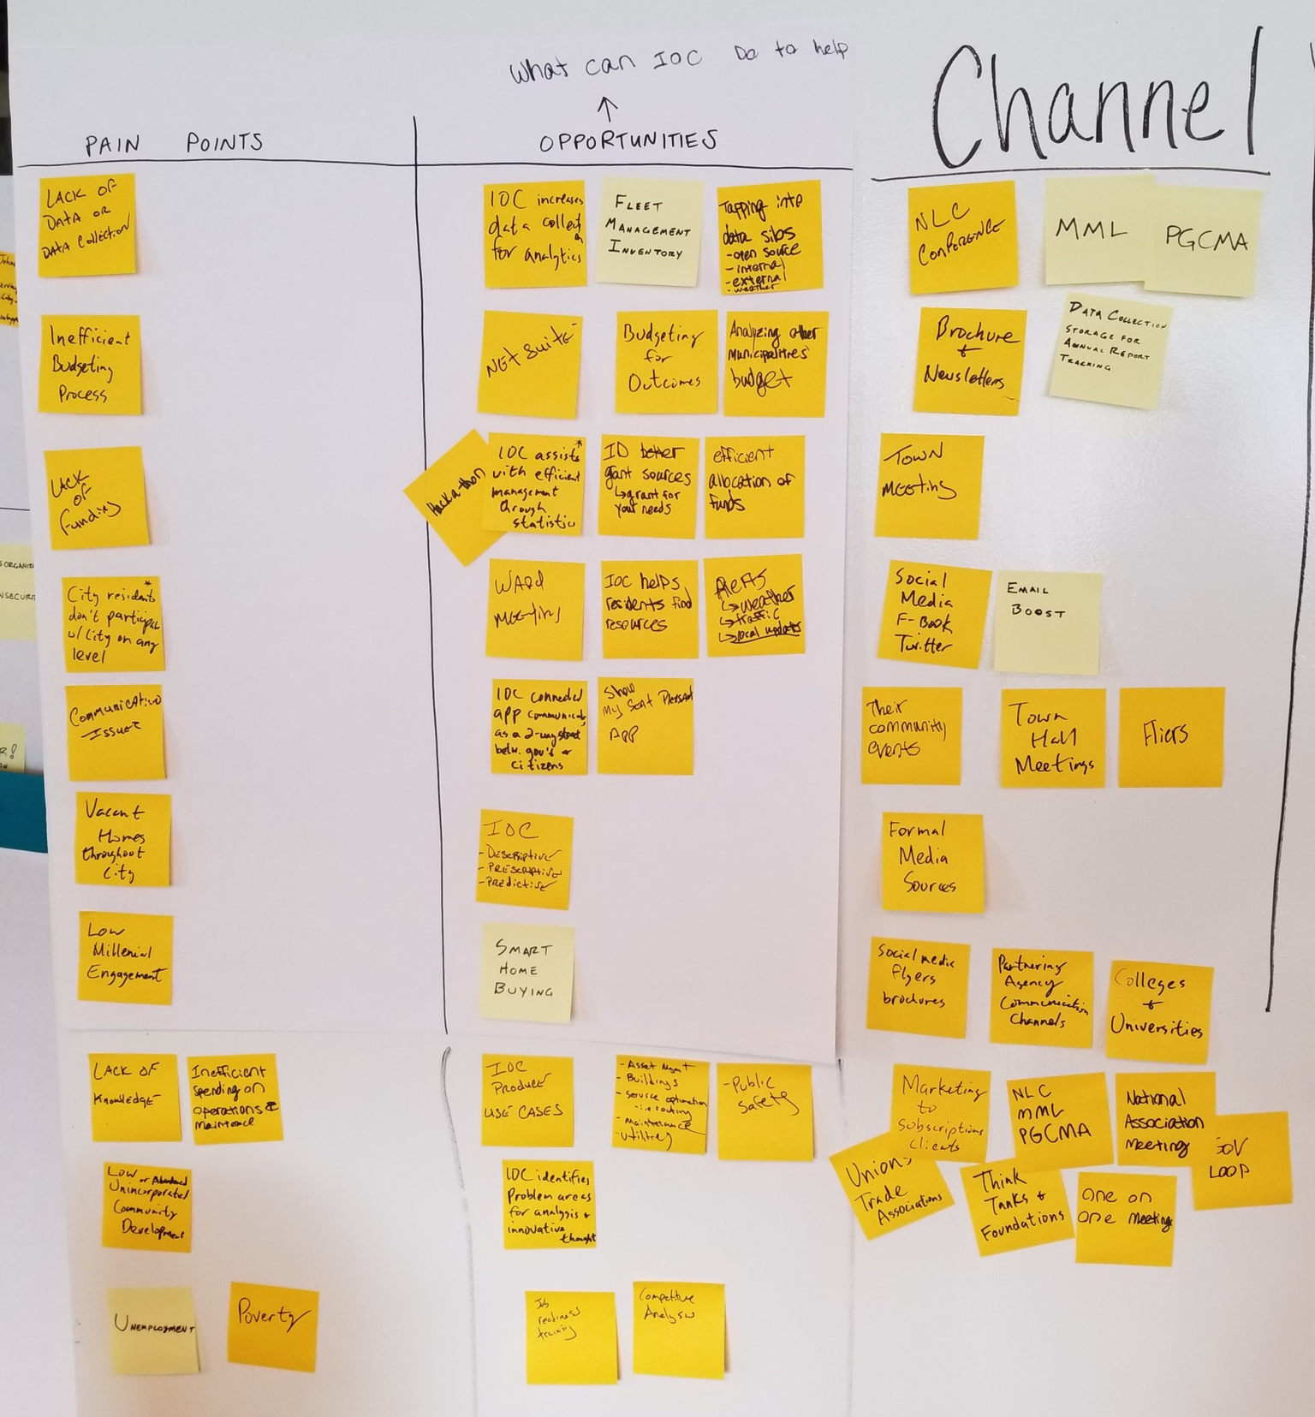
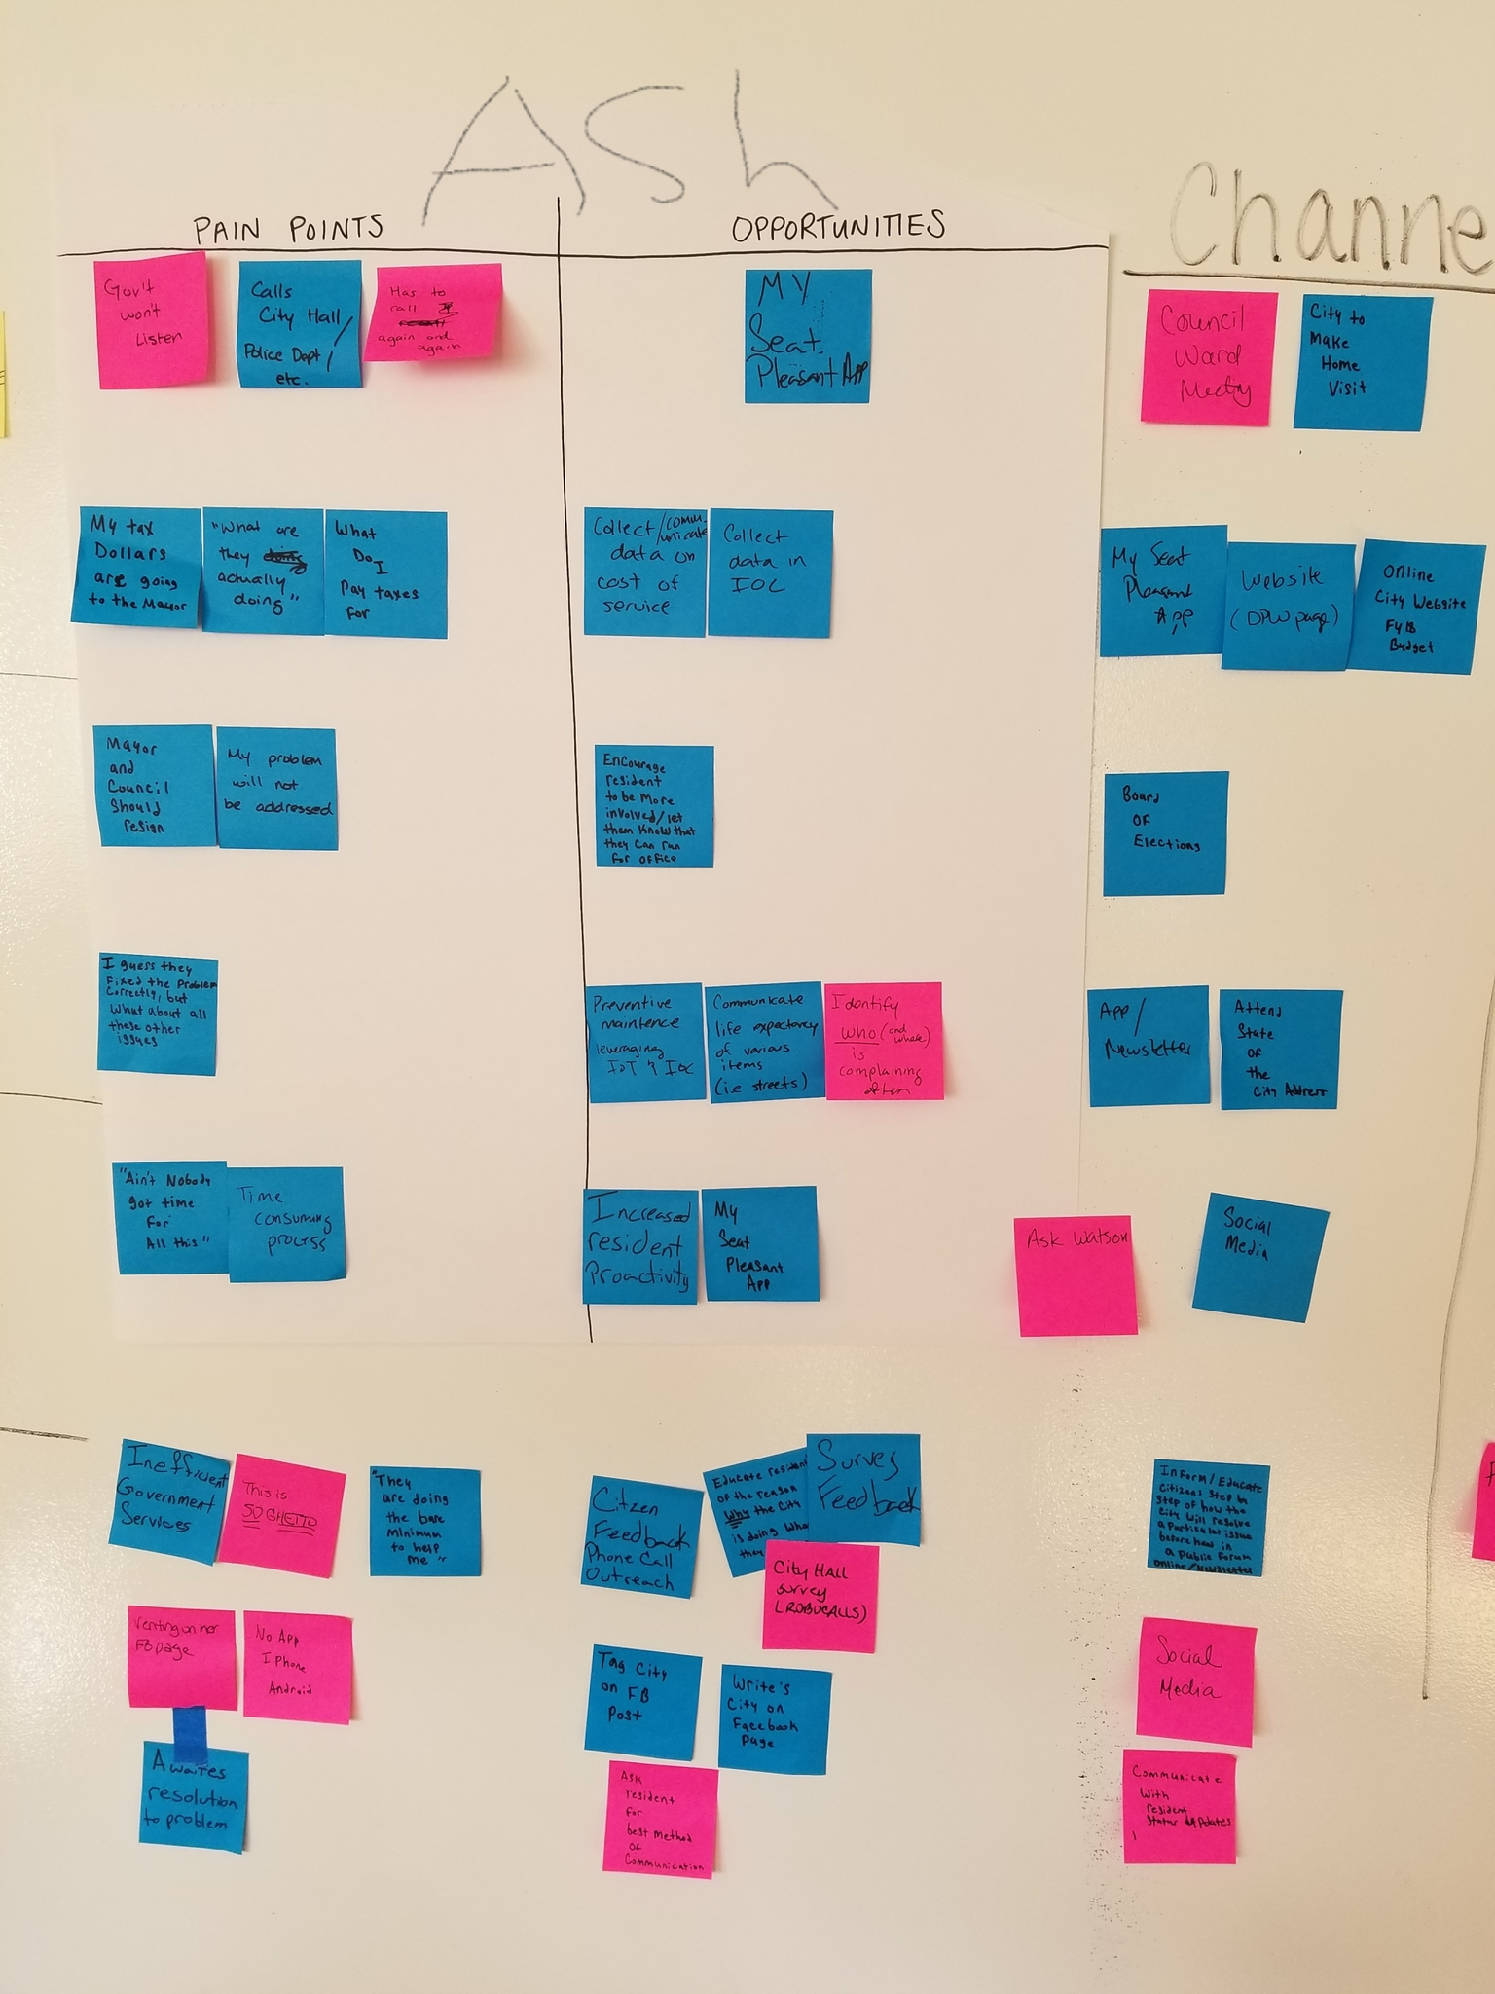
Pain Points & Opportunities Transcribed on the next page
19

Slide 20
Pain Points & Opportunities:
Wilma Johnson
Pain Points | Opportunities | Channels
Lack of data or data collected Inefficient budgeting process Lack of funding City residents don’t participate in city on any level Communication issues Vacant homes Low millennial engagement Lack of knowledge Low unincorporated community development Poverty Inefficient spending on operations & maintenance Unemployment | IOC increased data collection for analytics Fleet management inventory Tapping into data silos (Open source, internal, external, weather) Net Suite Budgeting for outcomes Analyzing other municipalities’ budgets Hackathon IOC assists with efficient management through statistics Efficient allocation of funds Ward meeting IOC helps residents find resources Alerts (weather, traffic, local updates) Show My Seat personal App Smart Home Buying IOC connected app communicator as a two-way street between government and citizens IOC-produced use cases IOC identifies problem areas for analysis and innovation Job readiness training Competitive analysis Asset Management Public safety Utilities | NLC Conference MML PGCMA Brochures & Newsletters Town Meeting Social Media (Facebook, Twitter) Email boost Community events Town Hall meetings Flyers Data collection storage for annual report tracking Formal media sources Partnering agency communication channels Colleges and universities Unions Trade Associations Think Tanks Foundations National Association Meeting One on One meetings Marketing to subscription clients Gov Loop

Slide 21
Pain Points & Opportunities:
Ashley M. Paint
Pain Points | Opportunities | Channels
Government won’t listen Has to call City Hall/ Police again and again Doesn’t understand what she pays taxes for and can’t see where that money is going Doesn’t think her problems will be addressed Even if the current problem is fixed, what about all the other issues? Interacting with the city is a time consuming process that she doesn’t have time for Government services are inefficient and not up to her standards The government is doing the bare minimum to meet her needs Venting to neighbors and on Facebook are the only things she can do while awaiting resolution of the problem | My Seat Pleasant App Collect and communicate data on the cost of services Collect data in IOC Encourage residents to be more involved in their local government Preventative maintenance leveraging IOT & IOC Communicate the life expectancy of things like streets Identify who is complaining often and where they are complaining from Encourage residents to be proactive Citizen feedback through surveys, phone calls, robocalls and outreach Educate residents on the reasons why the city is doing what they are doing Interact directly with city on social media Ask residents about their preferred method of communication (phone, text, email) Layout how the city will address a particular issues step-by-step Provide status updates for problems as they are resolved | Council Ward meeting Home visits My Seat Pleasant App City website FY18 budget Board of Elections Newsletter State of the City Address Ask Watson Social Media Public forum

Slide 22
Big Ideas
6
Once your team has a clear and validated understanding of your user’s problems and challenges, this activity is a great way for many people to rapidly brainstorm a breadth of possible ideas.

Slide 23
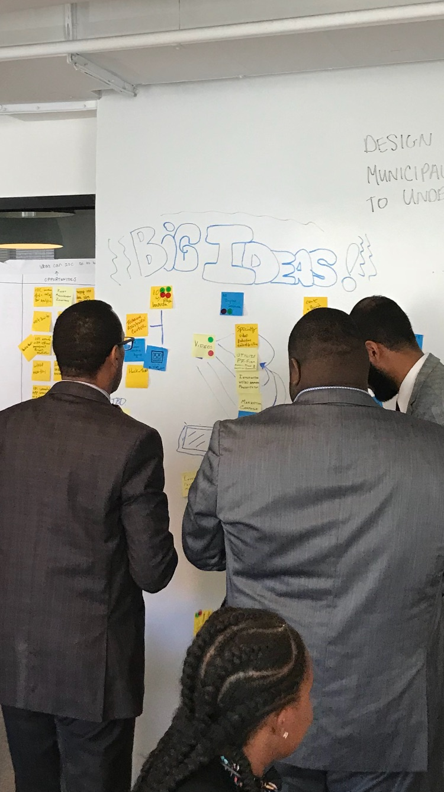
Big Ideas Transcribed on the next page
23

Slide 24
Big Ideas
Marketing and Communications
Global marketing discovery effort
Marketing Campaign
Branding strategy
Core messaging strategy
Videos
VLOG
Utilize PR Firm
Market Seat Pleasant as a destination spot
Verify city on all social media platforms
Bus stop and metro station billboards
Broadcast city meetings on Seat Pleasant TV channel (public access)
Technology
Live feed through IOC
Watson virtual agent
Preventative maintenance (If it ain’t broke, fix it!)
Technical assistance center
IOC + App Kiosks throughout city
Police Authorized city mobile surveillance
Environment protection monitoring
IOC w/ Village Innovation
Traffic cameras connected to IOC
All-digital services (digitization of paper forms)
Events and Engagement
Hackathon
Mobile Mayor
My Seat Pleasant App day sweepstakes
Citizen rewards points
Define candidate matrix
Metrics to determine target cities (evaluation criteria)
Commitment from target cities already identified
Infrastructure
Mixed-use development
Grocery Store
Incubator workspace
24

Slide 25
Big Idea Prioritization Exercise
7

Slide 26
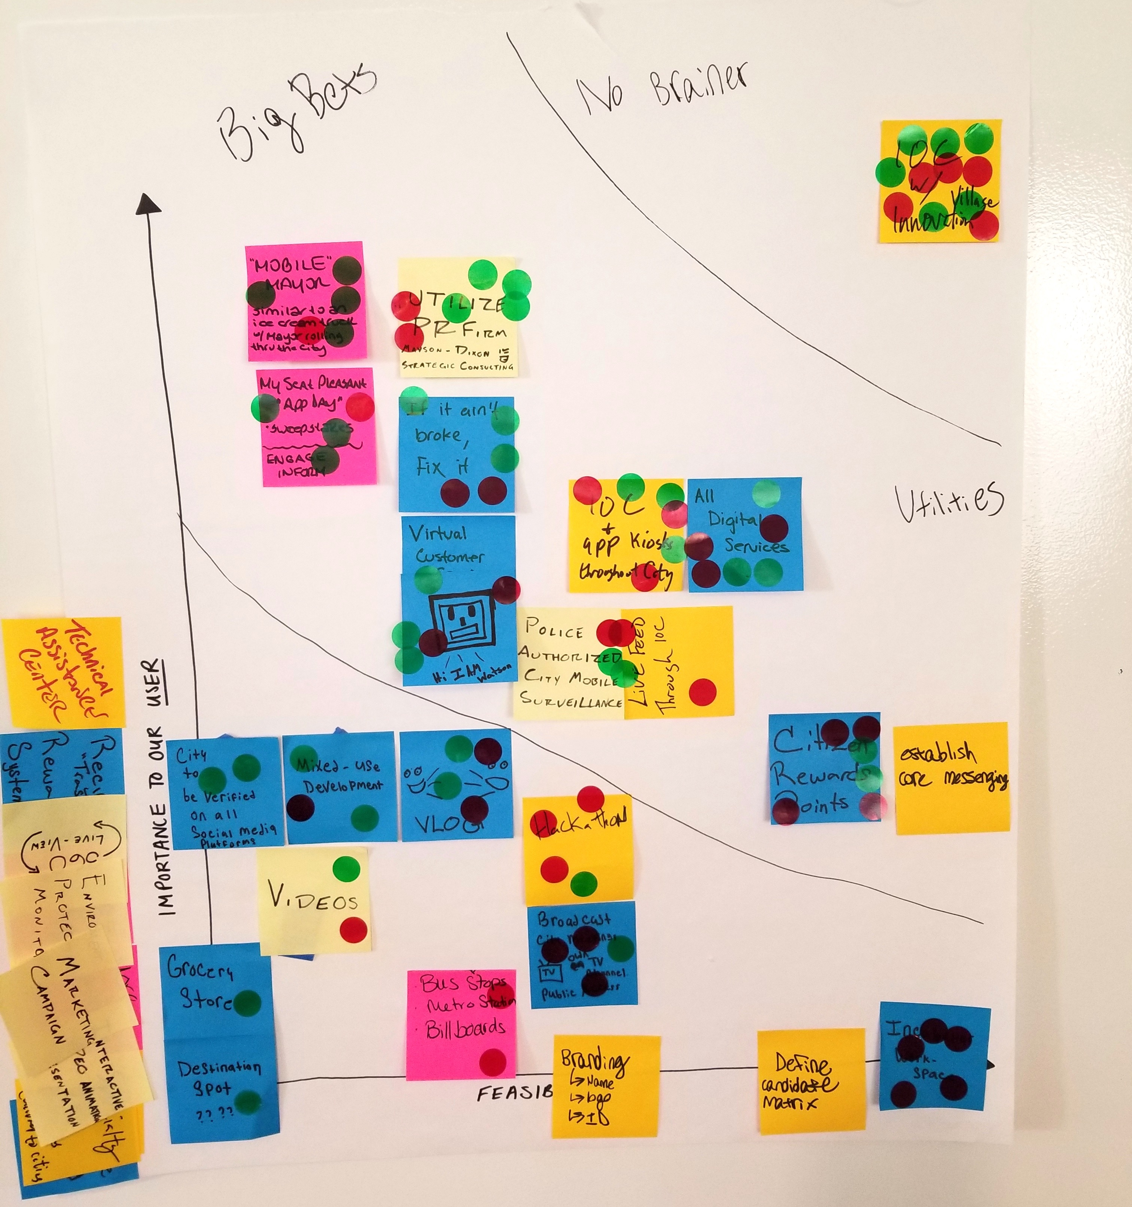
Big Idea Prioritization Exercise Transcribed on the next page
I = Impact
F = Feasibility
Participants were each given three dots for impact and three for Feasibility. They were asked to stick the dots on ideas they thought were most impactful and feasible.
30

Slide 27
Big Idea Prioritization Exercise
No Brainers
IOC with Innovation Village
Big Bets
Mobile Mayor
My Seat Pleasant App day sweepstakes
Utilize PR Firm
Preventative Maintenance (If it ain’t broke, fix it!)
Watson virtual agent
Police authorized city mobile surveillance
Live feed through IOC
Citizen rewards points
Establish core messaging
Digitize all services
IOC + App Kiosk
Other:
Verify city on all social media platforms
Mixed-use development
Grocery Store
Market Seat Pleasant as a destination
VLOG
Videos
Bus stop and metro station billboards
Hackathon
Branding strategy
Define candidate matrix
Broadcast city meetings on Seat Pleasant TV channel (public access)
31

Slide 28
Experience-Based Roadmapping
8

Slide 29
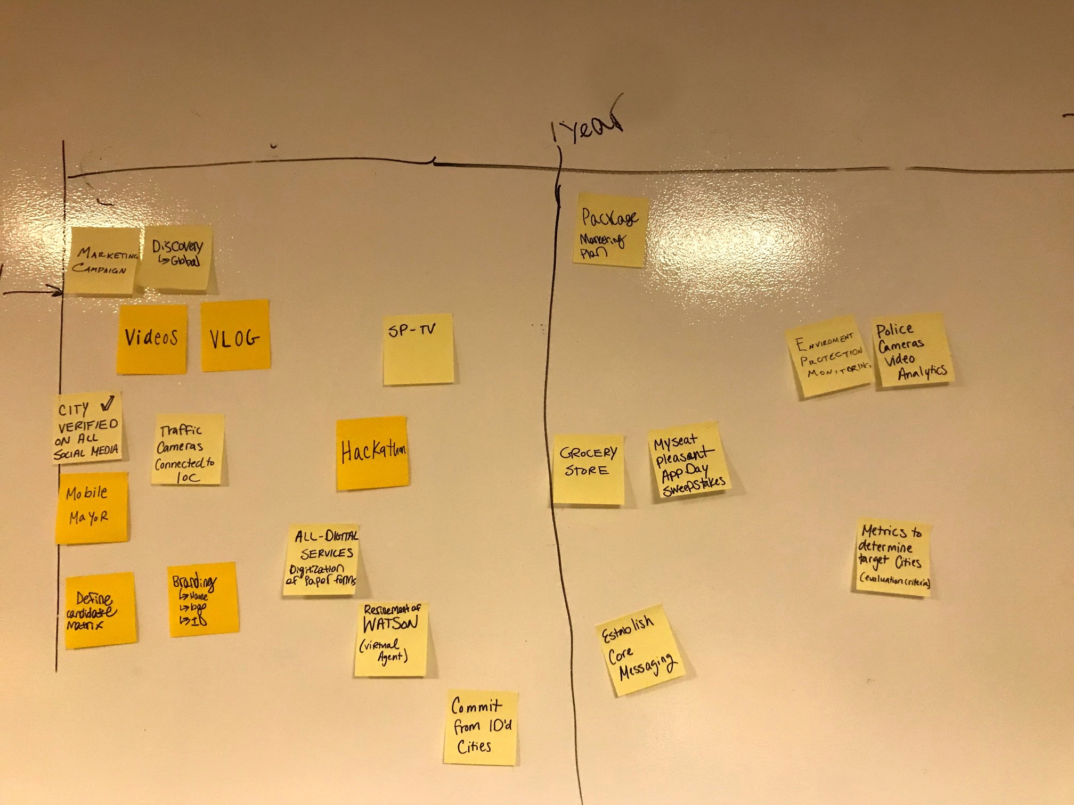
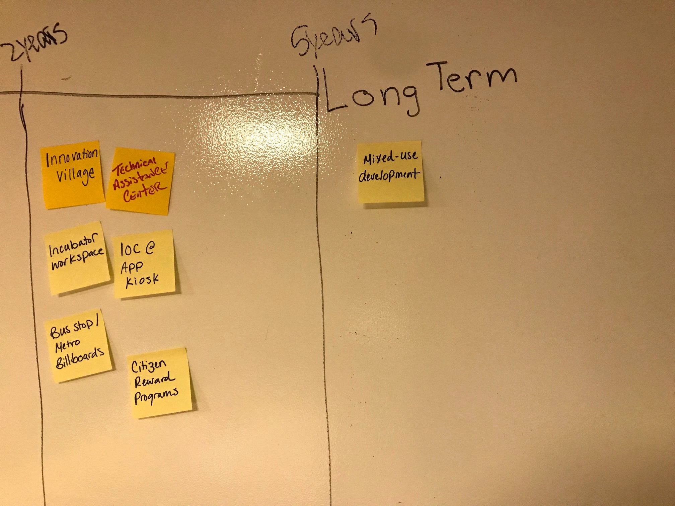
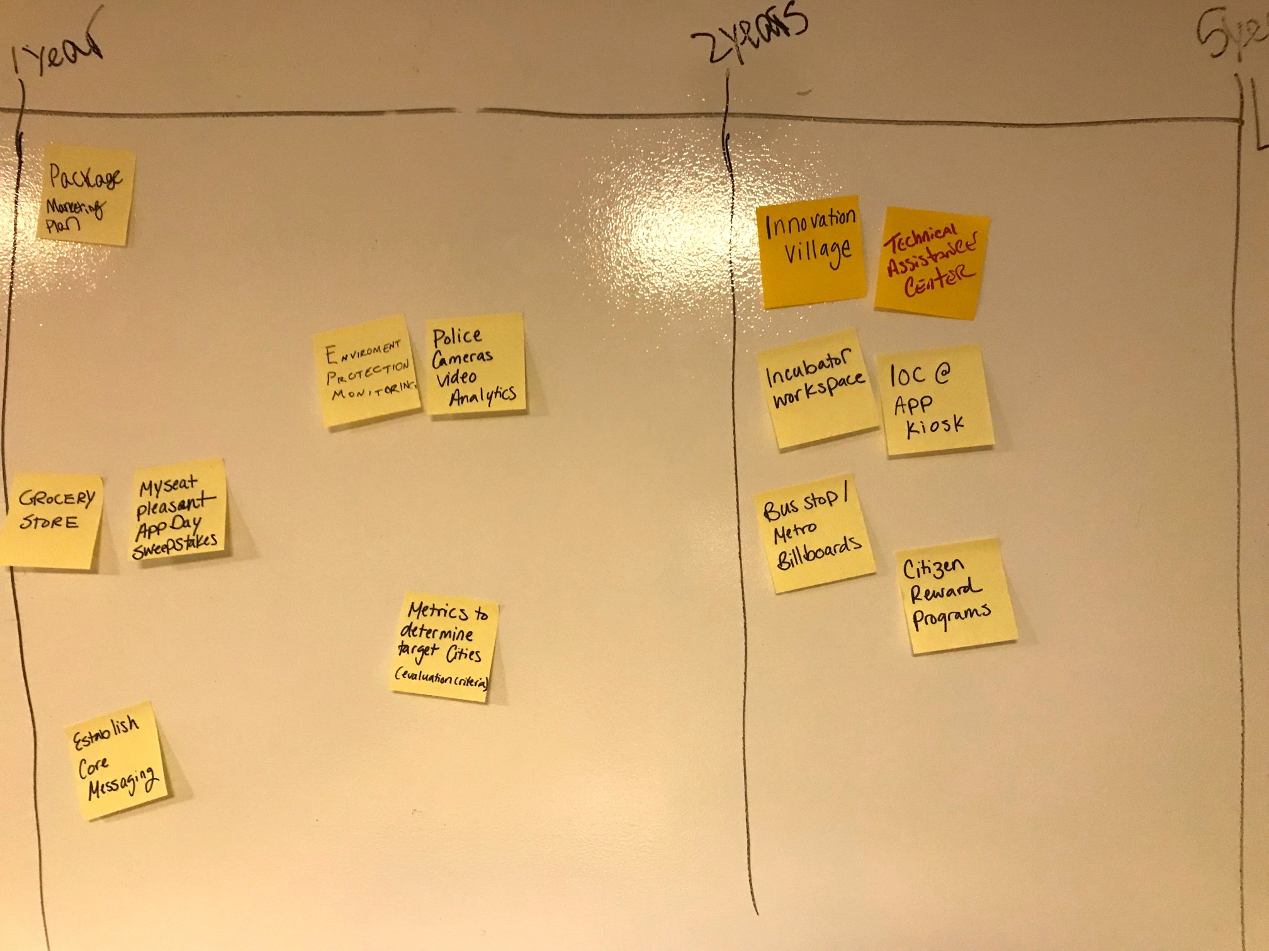
Experience-Based Roadmap Transcribed on the next page
34

Slide 30
Seat Pleasant Roadmap | Start February 2018
 | 2018 Immediate Term: Less than 1 year | 2018-19 Medium Term: 1-2 years | 2019 - 2021 Long Term: 2-5 years
Marketing and Communications | Global marketing discovery effort Marketing Campaign Videos Vlog Verify city on all social media platforms Branding strategy Seat Pleasant television | Package marketing plan Establish core messaging | Bus stop and metro station billboards
Technology | Traffic cameras connected to IOC Digitize all services Watson virtual agent | Environment protection monitoring Police Authorized city mobile surveillance | Innovation Village IOC @ App Kiosk Technical assistance center
Events & Engagement | Mobile Mayor Hackathon Define candidate matrix Commitment from target cities already identified | My Seat Pleasant App Day Sweepstakes Metrics to determine target cities (evaluation criteria) | Citizen rewards program
Infrastructure |  | Grocery store | Incubator Workspace Mixed-use development
35

Slide 31
For more information on IBM Design Thinking, visit: ibm.com/design/thinking

